Slide 1
Transition-Based Dependency Parsing
纪焘

Slide 2
Transition-Based Dependency Parsing
Part.1

Slide 3
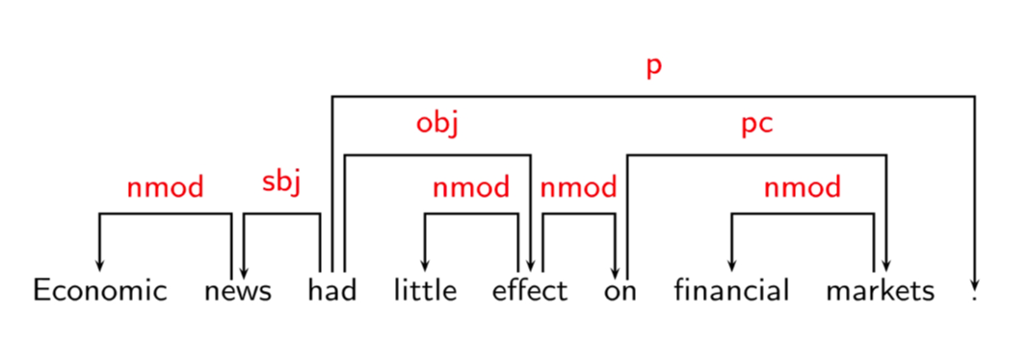
Transition-Based Dependency Parsing
Dependency Syntax

Slide 4
Transition-Based Dependency Parsing
Dependency Syntax
The sentence is an organized whole, the constituent elements of which are words.
Every word that belongs to a sentence ceases by itself to be isolated as in the dictionary. Between the word and its neighbors, the mind perceives connections, the totality of which forms the structure of the sentence.
The structural connections establish dependency relations between the words. Each connection in principle unites a superior term and an inferior term.
The superior term receives the name governor. The inferior term receives the name subordinate.

Slide 5
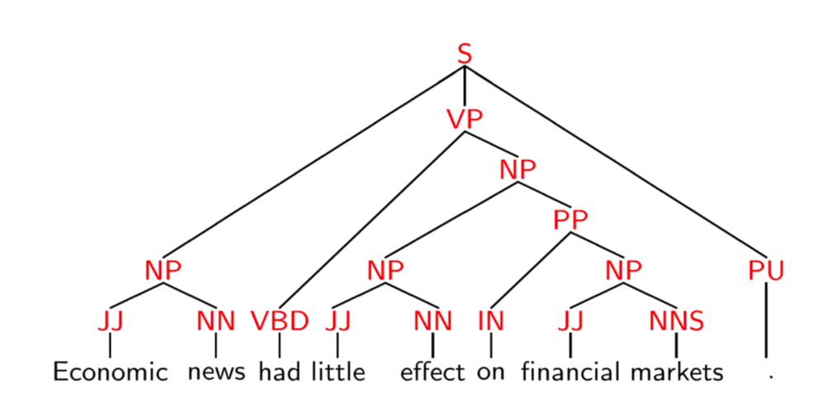
Transition-Based Dependency Parsing
Phrase Structure

Slide 6
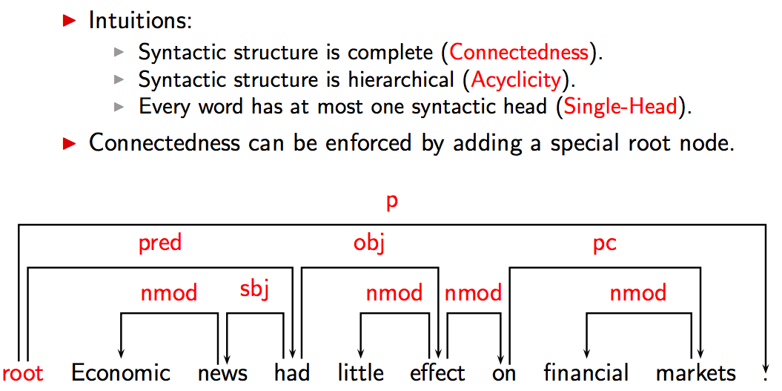
Transition-Based Dependency Parsing
Connectedness, Acyclicity and Single-Head

Slide 7
Transition-Based Dependency Parsing
Example: Shift-Reduce Parsing

Slide 8
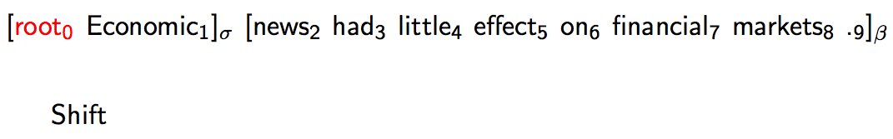
Transition-Based Dependency Parsing
Example: Shift-Reduce Parsing

Slide 9
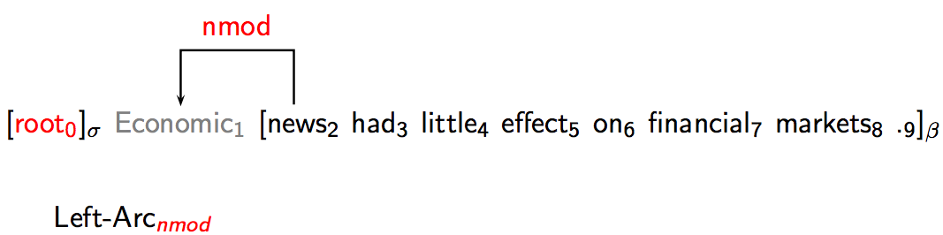
Transition-Based Dependency Parsing
Example: Shift-Reduce Parsing

Slide 10
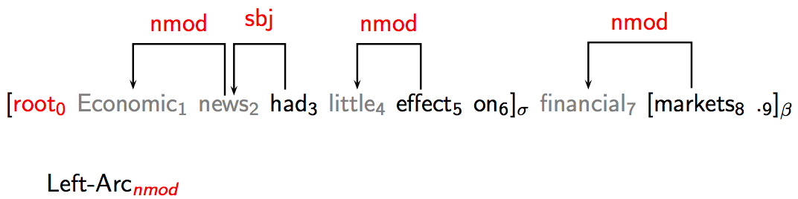
Transition-Based Dependency Parsing
Example: Shift-Reduce Parsing

Slide 11
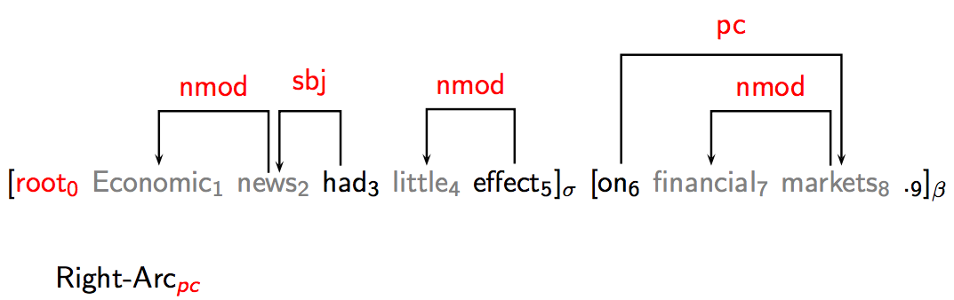
Transition-Based Dependency Parsing
Example: Shift-Reduce Parsing

Slide 12
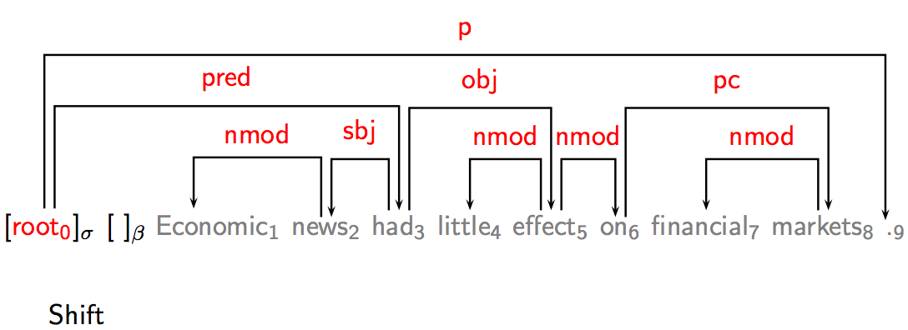
Transition-Based Dependency Parsing
Example: Shift-Reduce Parsing

Slide 13
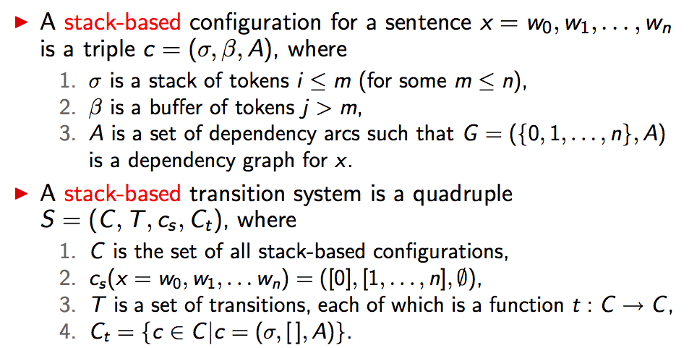
Transition-Based Dependency Parsing
Stack-Based Transition Systems

Slide 14
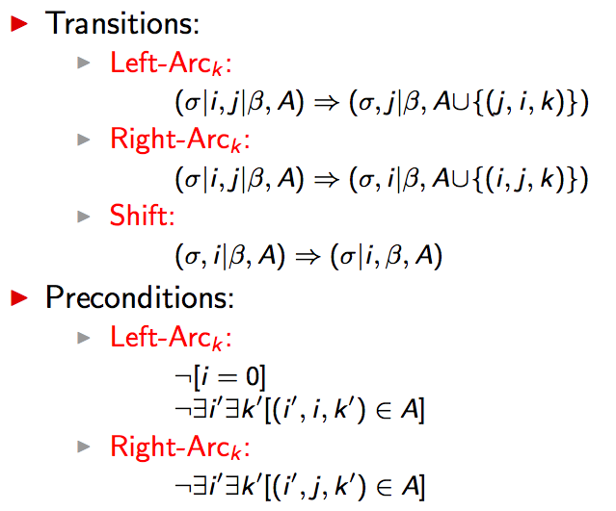
Transition-Based Dependency Parsing
Shift-Reduce Dependency Parsing

Slide 15
Transition-Based Dependency Parsing
Example: Shift-Reduce Parsing

Slide 16
Transition-Based Dependency Parsing
Q&A

Slide 17
Transition-Based Dependency Parsing
Part.2

Slide 18
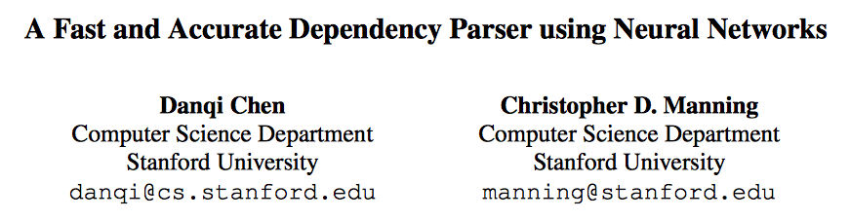
Transition-Based Dependency Parsing

Slide 19
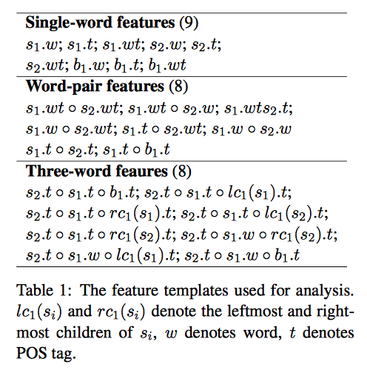
Transition-Based Dependency Parsing
Feature Templates

Slide 20
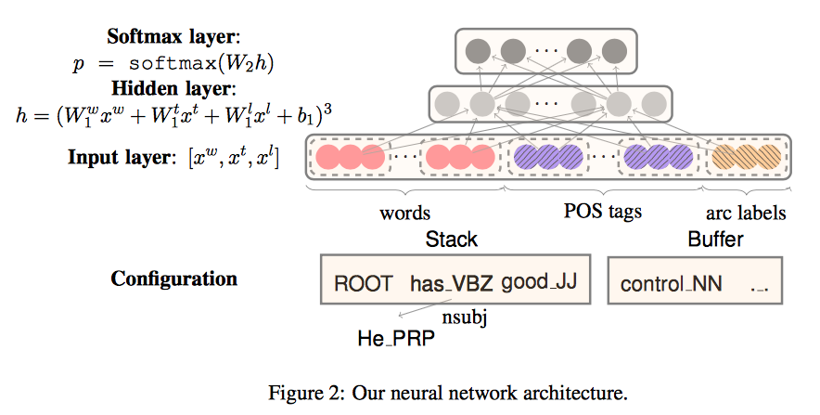
Transition-Based Dependency Parsing
Network Architecture

Slide 21
Transition-Based Dependency Parsing
Parameter Description
W contains nw = 18 elements:
The top 3 words on the stack and buffer: s1, s2, s3, b1, b2, b3;
The first and second leftmost / rightmost children of the top two words on the stack: lc1(si), rc1(si), lc2(si), rc2(si), i = 1, 2.
The leftmost of leftmost / rightmost of right- most children of the top two words on the stack: lc1(lc1(si)), rc1(rc1(si)), i = 1, 2.
T~W
L excluding those 6 words on the stack/buffer

Slide 22

Transition-Based Dependency Parsing
Training
The final training objective is to minimize the cross-entropy loss, plus a l2-regularization term:
θ is the set of all parameters.

Slide 23
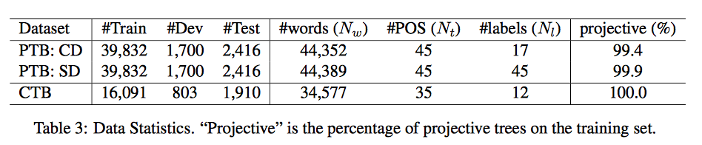
Transition-Based Dependency Parsing
Experiments

Slide 24
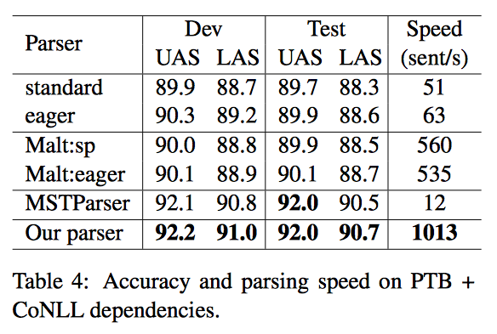
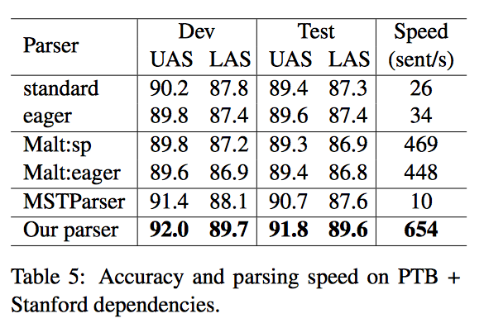
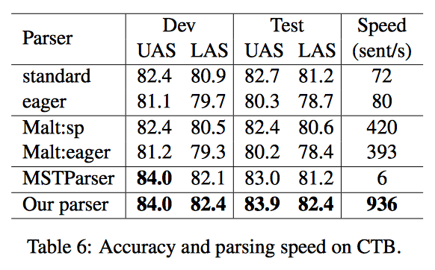
Transition-Based Dependency Parsing
Experiments

Slide 25
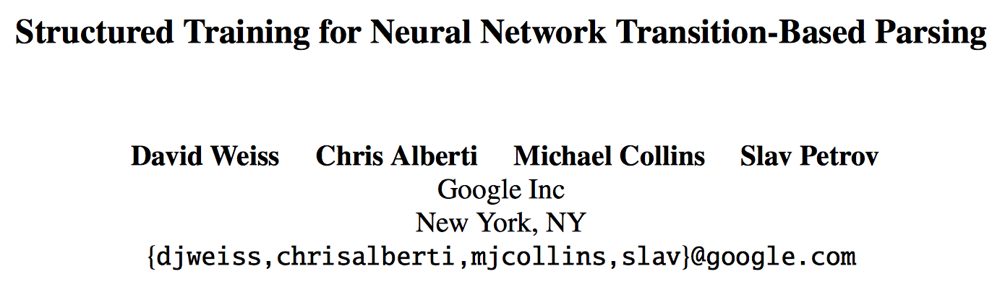
Transition-Based Dependency Parsing

Slide 26
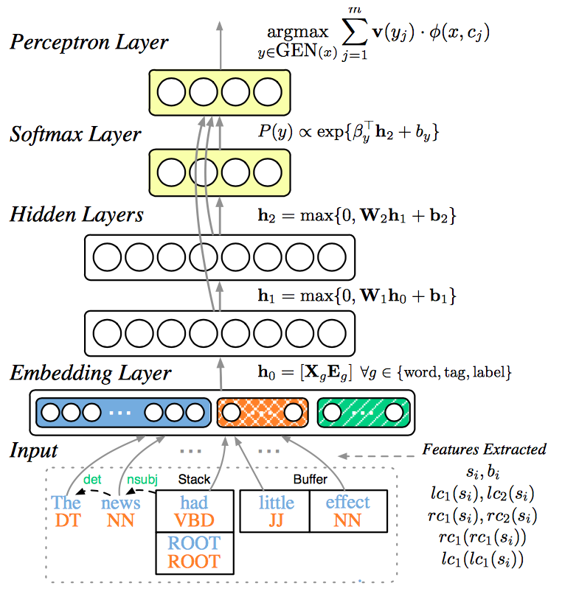
Transition-Based Dependency Parsing
Neural Network Model

Slide 27
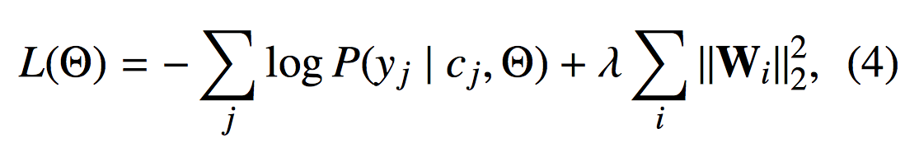
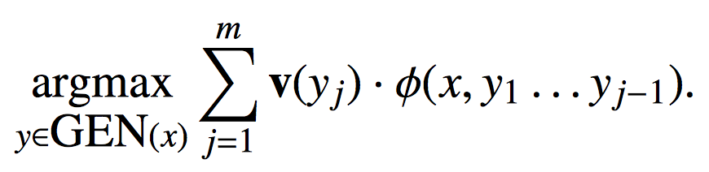
Transition-Based Dependency Parsing
Training
Decoding

Slide 28
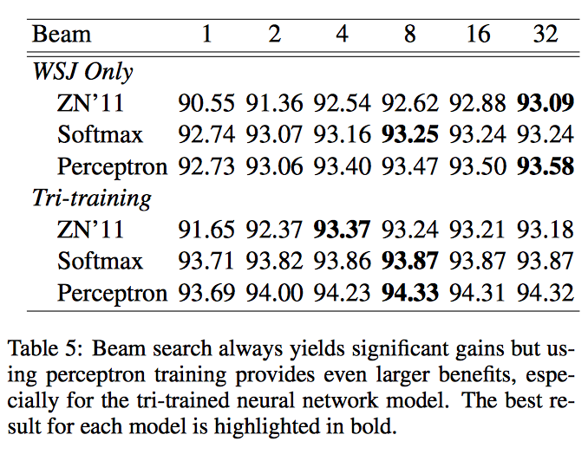
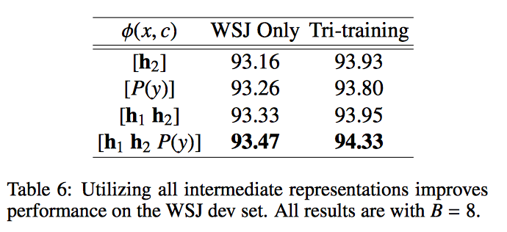
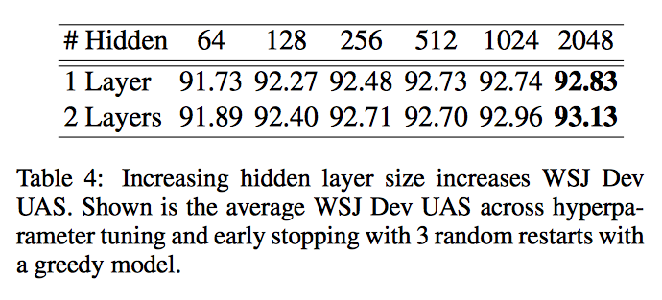
Transition-Based Dependency Parsing
Experiments

Slide 29
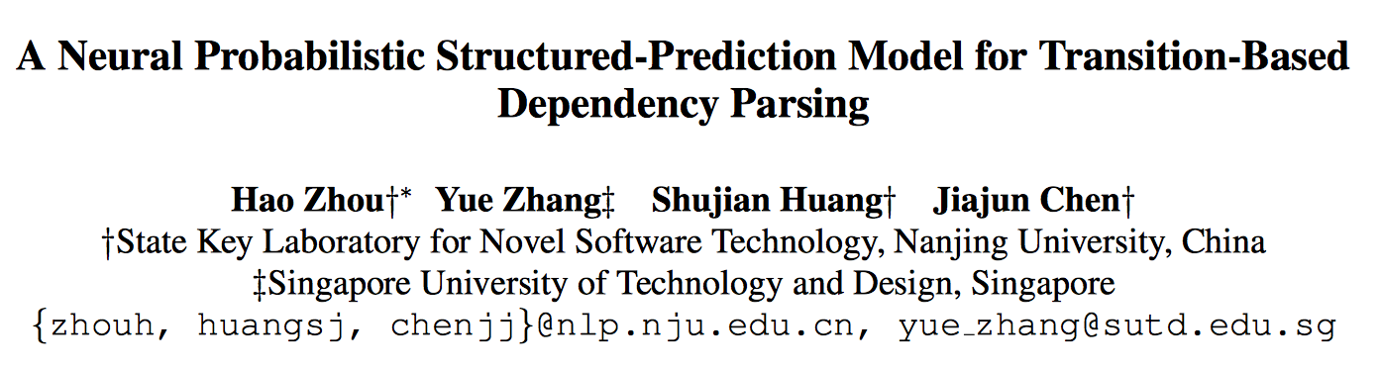
Transition-Based Dependency Parsing

Slide 30
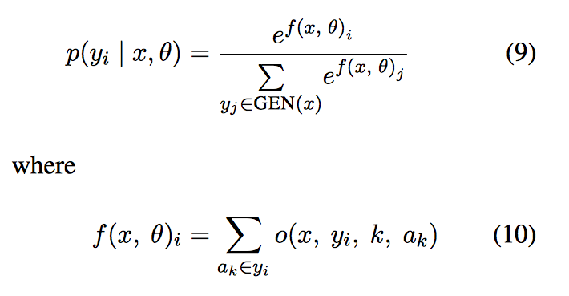
Transition-Based Dependency Parsing
Training&Decoding

Slide 31
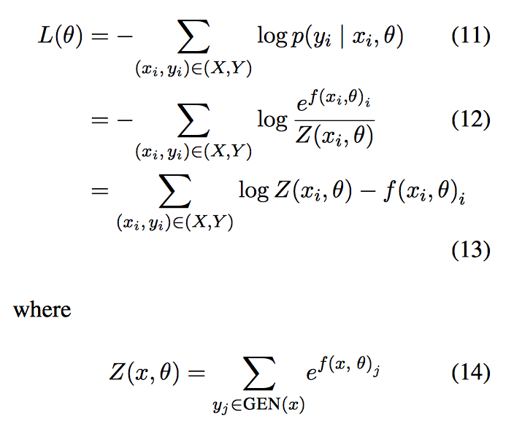
Transition-Based Dependency Parsing
Training&Decoding

Slide 32
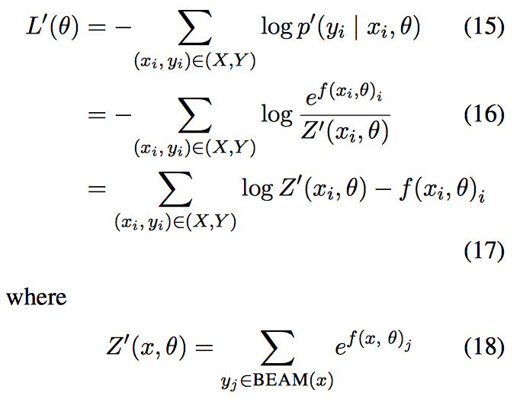
Transition-Based Dependency Parsing
Training&Decoding

Slide 33
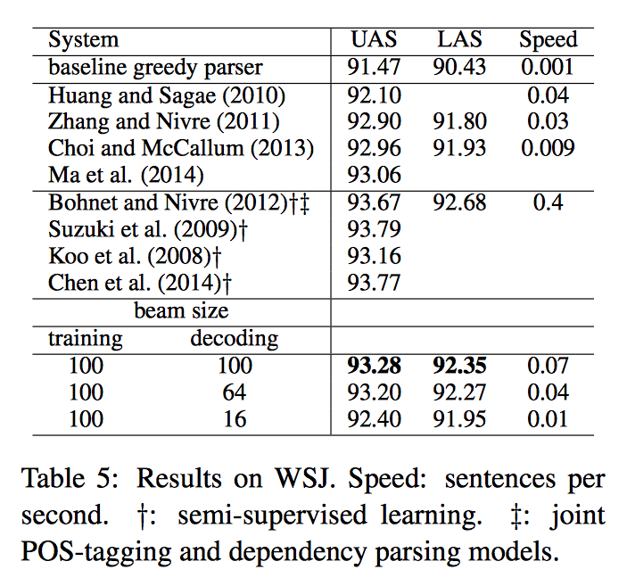
Transition-Based Dependency Parsing
Experiments

Slide 34
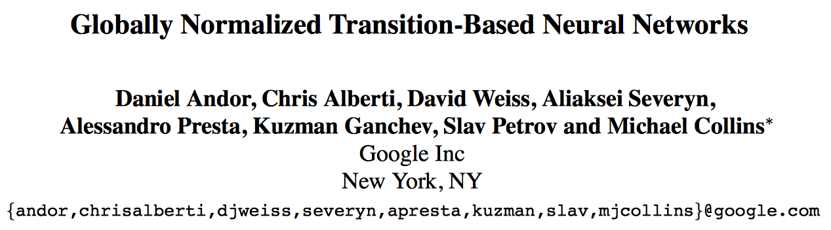
Transition-Based Dependency Parsing

Slide 35
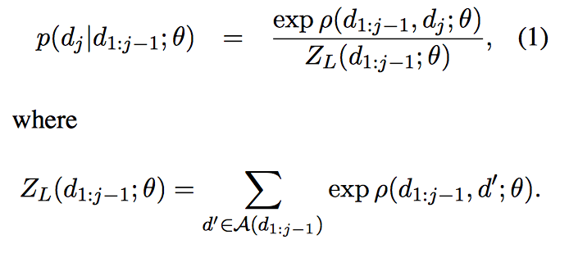
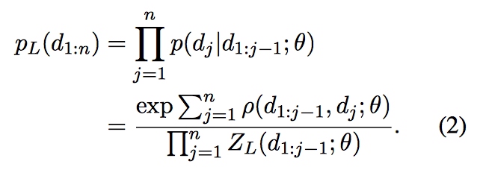
Transition-Based Dependency Parsing
Global vs. Local Normalization

Slide 36
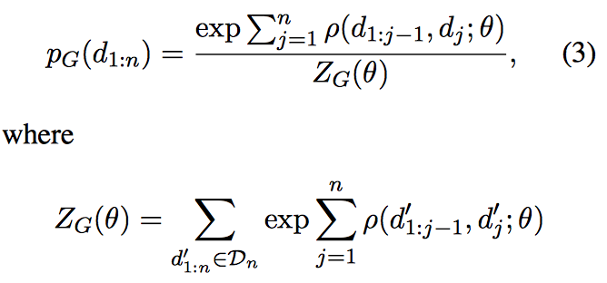
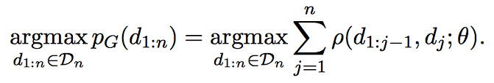
Transition-Based Dependency Parsing
Global vs. Local Normalization

Slide 37
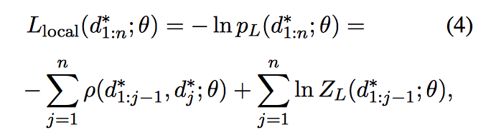
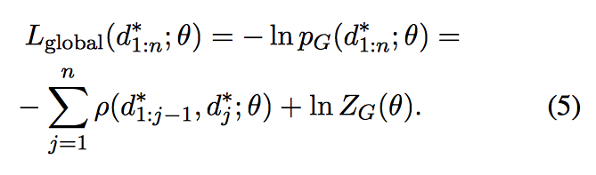
Transition-Based Dependency Parsing
Training

Slide 38
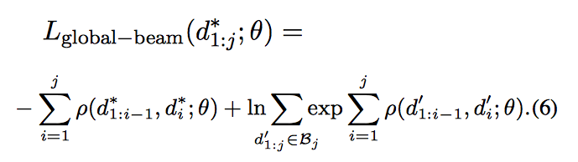
Transition-Based Dependency Parsing
Training

Slide 39
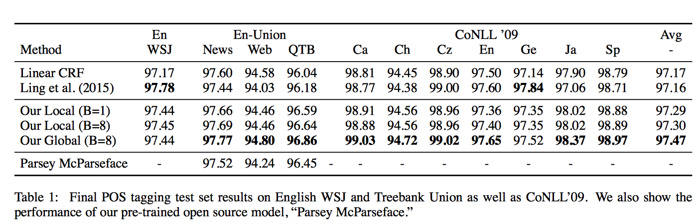
Transition-Based Dependency Parsing
Experiments

Slide 40
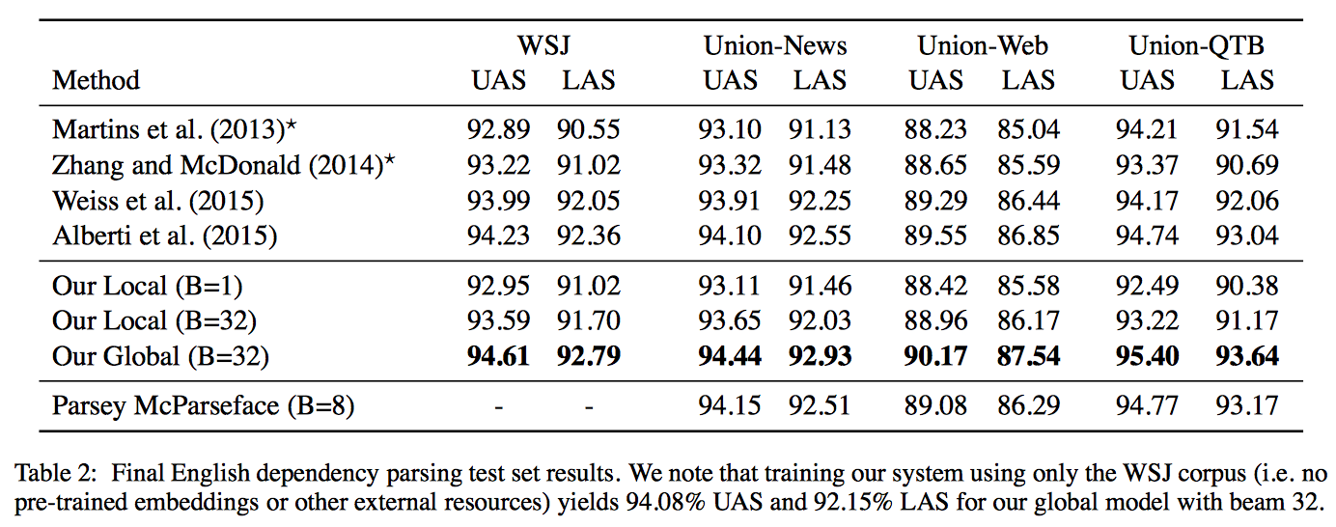
Transition-Based Dependency Parsing
Experiments

Slide 41
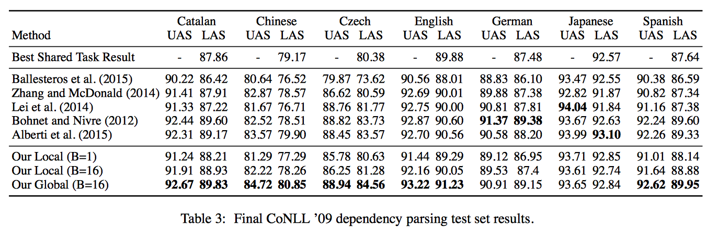
Transition-Based Dependency Parsing
Experiments

Slide 42
Transition-Based Dependency Parsing
Q&A

